Slide 1

Error Mitigation - Clifford Data Regression
Rajesh Sathya Kumar

Slide 2
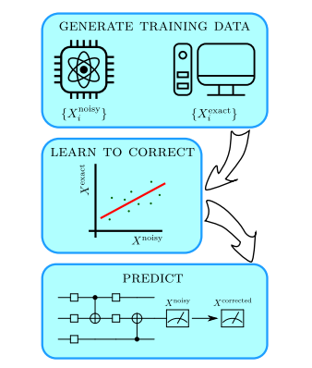
Model of CDR
Figure 1: proposed error mitigation method for Clifford Data Regression. Cited from: Czarnik, P., Arrasmith, A., Coles, P. J. & Cincio, L. Error mitigation with clifford quantum-circuit data. Preprint at https://arxiv.org/abs/ arXiv:2005.10189 (2020).

Slide 3
Clifford Data Regression
Clifford data regression (CDR) is a learning-based quantum error mitigation technique in which an error mitigation model is trained with quantum circuits that resemble the circuit of interest, but which are easier to classically simulate
Steps:
Define a Quantum Circuit
Define an Executor
Define an Observable
Define a Near-Clifford Simulator

Slide 4
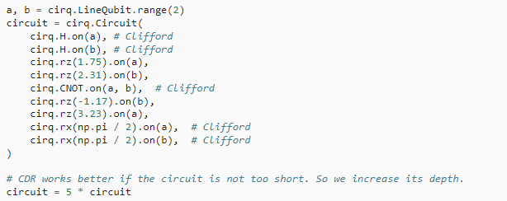
Quantum Circuit - Cirq

Slide 5



Defining Executor, Observable and Simulator

Slide 6
Results
Ideal Expectation Value: 1.0153722348622978 unmitigated_measurement = 0.8030939371092245
mitigated_measurement = 1.0349693115897316
Error reduction with CDR: 90.8%.

Slide 7
Reference Paper:
[1] Czarnik, P., Arrasmith, A., Coles, P. J. & Cincio, L. Error mitigation with clifford quantum-circuit data. Preprint at https://arxiv.org/abs/ arXiv:2005.10189 (2020).
Next Steps:
Look into PEC (Probabilistic Error Correction)
I was able to run the neural network quantum circuit and assess benchmarks, but the depth varies on every iteration due to the optimization step. Couldn’t use that as scalability
Looking at:
i) Benchmarking neural networks for quantum computation, N.H. Nguyen, E.C. Behrman, M.A. Moustafa, J.E. Steck
https://arxiv.org/abs/1807.03253
2. Once I can get some benchmarks for quantum neural networks, planning to use Mitiq with quantum algorithms.

